Slide 1
UNITED COLLEGE OF ENGINEERING
AND RESEARCH.
A PROJECT ON
RAILWAY RESERVATION SYSTEM USING SPRINBOOT
(BACHELOR OF COMPUTER SCIENCE )
BY
KASHISH KUSHWAHA
&
KHUSHI MAURYA
Under the Guidance of
DHANANJAY SHARMA

Slide 2
PURPOSE AND SCOPE OF PROJECT
A Railway Reservation System is a Software Application Designed to manage and automate the process of booking train tickets anytime and anywhere.
This Application will manage large amount of data within the database.
The railway reservation system portal is a web-based application that enables users to book railway tickets online. The system will allow the users to book available trains based on their source and destination cities, reserve the seats according to their needs.
The system will provide a dashboard for the admin to manage their train related operations.

Slide 3
PROPOSED SYSTEM
Computerized system speeds up the all activities such as record management, train management, user details , ticket management thus making it easier for the customers and user friendly ,removing last minute rush at the railway stations for booking tickets.
Decreases the manual work, therefore reduces errors .
This system stores the information about the user details and the train details along with admin details.

Slide 4
MODULE WISE FUNCTIONALITIES
USER MODULE: User Management Module
User Registration/Login: Allows new users to create an account and existing users to log in securely.
Profile Management: Users can update personal information, view booking history, and manage preferences.
ADMIN MODULE:
User Management (for admins): Admins can view, modify, or delete user accounts .(CRUD OPERATION USING SPRINGBOOT)
Train and Schedule Management: Allows admins to update train details, schedules, and routes.

Slide 5
TRAIN MODULE
Train Management Module
Train Scheduling: Administrators can create and modify train schedules, including departure and arrival times.
Route Management: Defines routes for each train, including stops.
Train Status Updates: Provides real-time updates on train statuses, such as delays or cancellations.
TICKET MODULE
Reservation Module
Seat Availability Check: Users can check available seats for specific trains and classes.
Booking Tickets: Facilitates the process of selecting seats and completing ticket purchases.
Canceling Tickets: Allows users to cancel their bookings.

Slide 6
BOOKING MODULE
Search Functionality: Users can input travel details (source, destination, date) to find available trains.
Display Availability: Shows real-time seat availability for different classes (e.g., Sleeper, AC) on selected trains.
Filters: Allows users to filter results based on preferences (e.g., price range, travel time).
LOGIN MODULE
Username/Email and Password Entry: Users provide their registered username or email along with their password to access their accounts.
User Sign-Up: Provides an option for new users to register directly from the login page, redirecting them to the registration module.

Slide 7
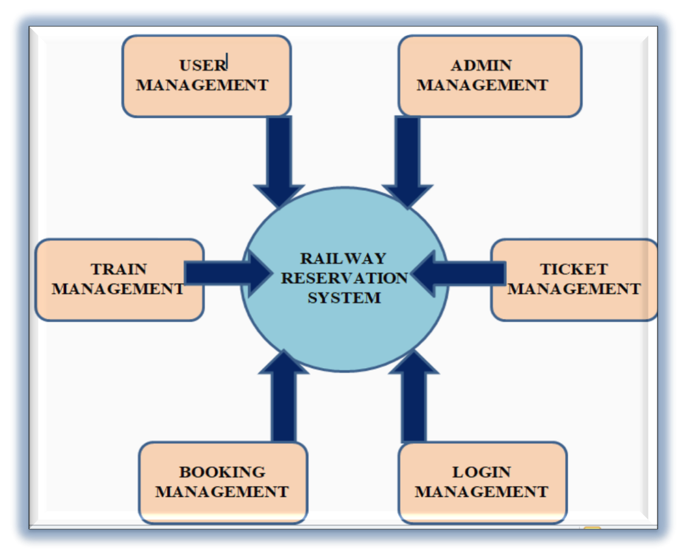
DATA FLOW DIAGRAM

Slide 8
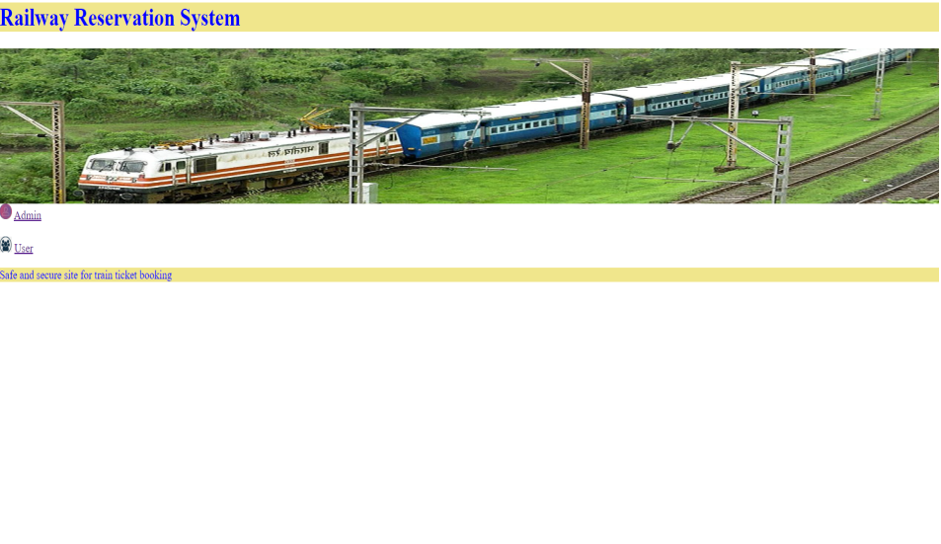
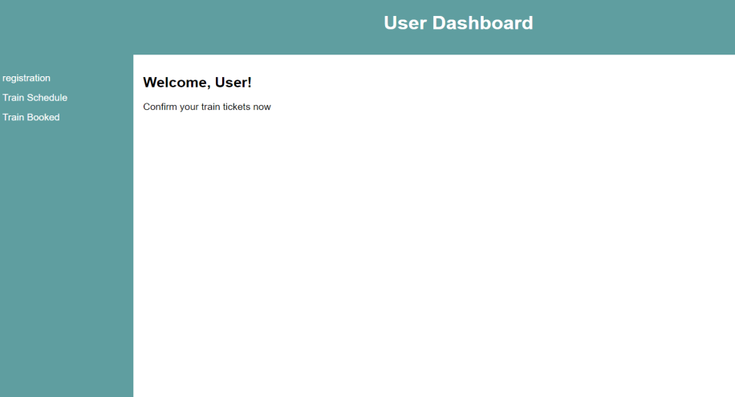
SNAPSHOTS

Slide 9
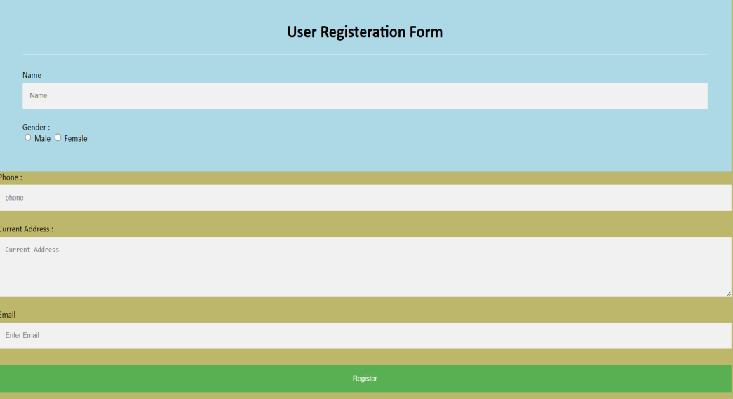
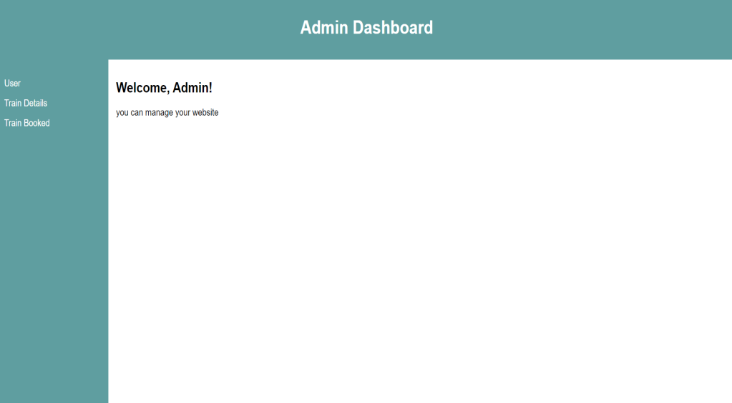

Slide 10
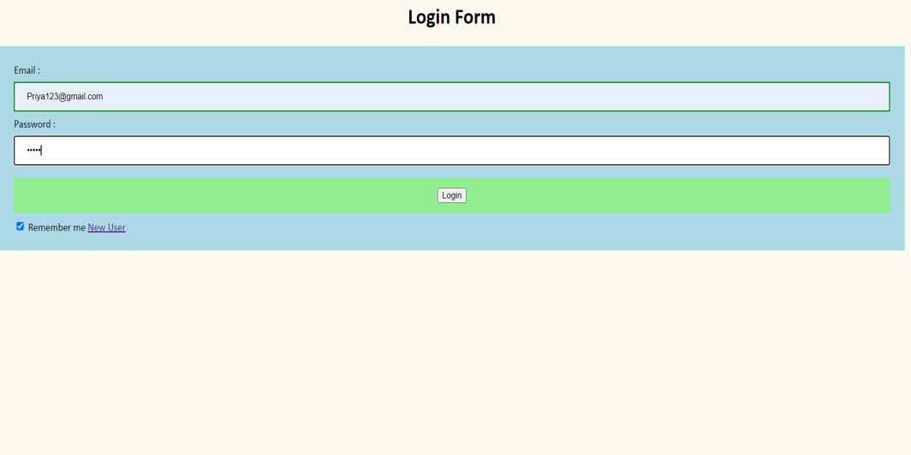

Slide 11
TECHNOLOGY USED
Software Interface
Front End : - HTML,CSS
Operating System- Windows 10 WITH SPRINGTOOL SUITE INSTALLED IN IT.
Back End : Microsoft SQL
Hardware Interface
Display - Color Monitor
RAM - 512 MB
GOOD INTERNET CONNECTION AND PC.

Slide 12
THANK YOU

